Slide 1






Early Alzheimer’s
Diagnosis Using VR
24-1-D-17
Advisors: Dr. Anat Dahan
Dr. Marcela Viviana Karpuj
By: Aviv Ben Ezra
Tali Azoulay

Slide 2
Table of contents
Importance of Early Detection in Alzheimer's Disease……………………………………………………………………………………………………….3
Current Diagnosis Process …………………………………………………………………………………………………………………………………………………4
What Is Virtual Supermarket Test (VST)? ……………………………………………………………………………………………………………………....….5
Short Movie ………………………………………………………………………………………………………………………………………………………………………6
Scenes and Flow: Navigating Through The Diagnostic Game ……………………………………………………………………………………………..7
User Manual: Guide for Setup and Operation ………………………………………………………………………………………………………….……….13
Challenges and Solutions ………………………………………………………………………………………………………………….………………………………16
Decisions: Key Choices in Development Process ……………………………………………………………………………………………………….………17
Tools: Essential Application for Development …………………………………………………………………………………………………………….....…20
Testing: Ensuring Functionality and Usability ……………………………………………………………………………………………………………………21
Future Features …………………………………………………………………………………………………………………………………………………………..……22
Summarize ………………………………………………………………………………………………………………………………………………………………….……23

Slide 3

Importance of Early Detection in Alzheimer's Disease
Innovative Diagnostic Tools
Cognitive Impairments
Virtual reality diagnostic tools, like the VR-based diagnostic game discussed, offer innovative solutions for early Alzheimer's detection.
Early identification of cognitive impairments, such as difficulties with spatial navigation, helps distinguish Alzheimer's from other forms of dementia in the early stages, even before brain changes become visible.
Tailored Treatments
Importance of Early Detection
Detecting Alzheimer's disease in its early stages enables tailored treatments that can significantly impact patients' lives.
Early detection of Alzheimer's disease is crucial for improving patient outcomes and quality of life. Timely diagnosis allows for the implementation of appropriate care strategies to slow disease progression.
3
/
Early Alzheimer’s Diagnosis Using VR

Slide 4

Current Diagnosis Process
Doctors Says
“Having a tool capable of assessing these factors in just 5 minutes would be extremely beneficial to their practice, as it would streamline the diagnostic process, reduce time pressures, and improve patient management within the constraints of limited space and resources“.
Diagnosis Process
Diagnosing Alzheimer's disease in its early stages is challenging and complex. Currently, assessing a patient's ability to navigate and evaluating their performance in daily activities are particularly.
Constraints
Healthcare settings often face constraints of limited space, personnel, and time. With these limitations, doctors and staff may struggle to conduct thorough assessments, particularly when diagnosing complex conditions like lack of navigation skill.
4
/
Early Alzheimer’s Diagnosis Using VR

Slide 5
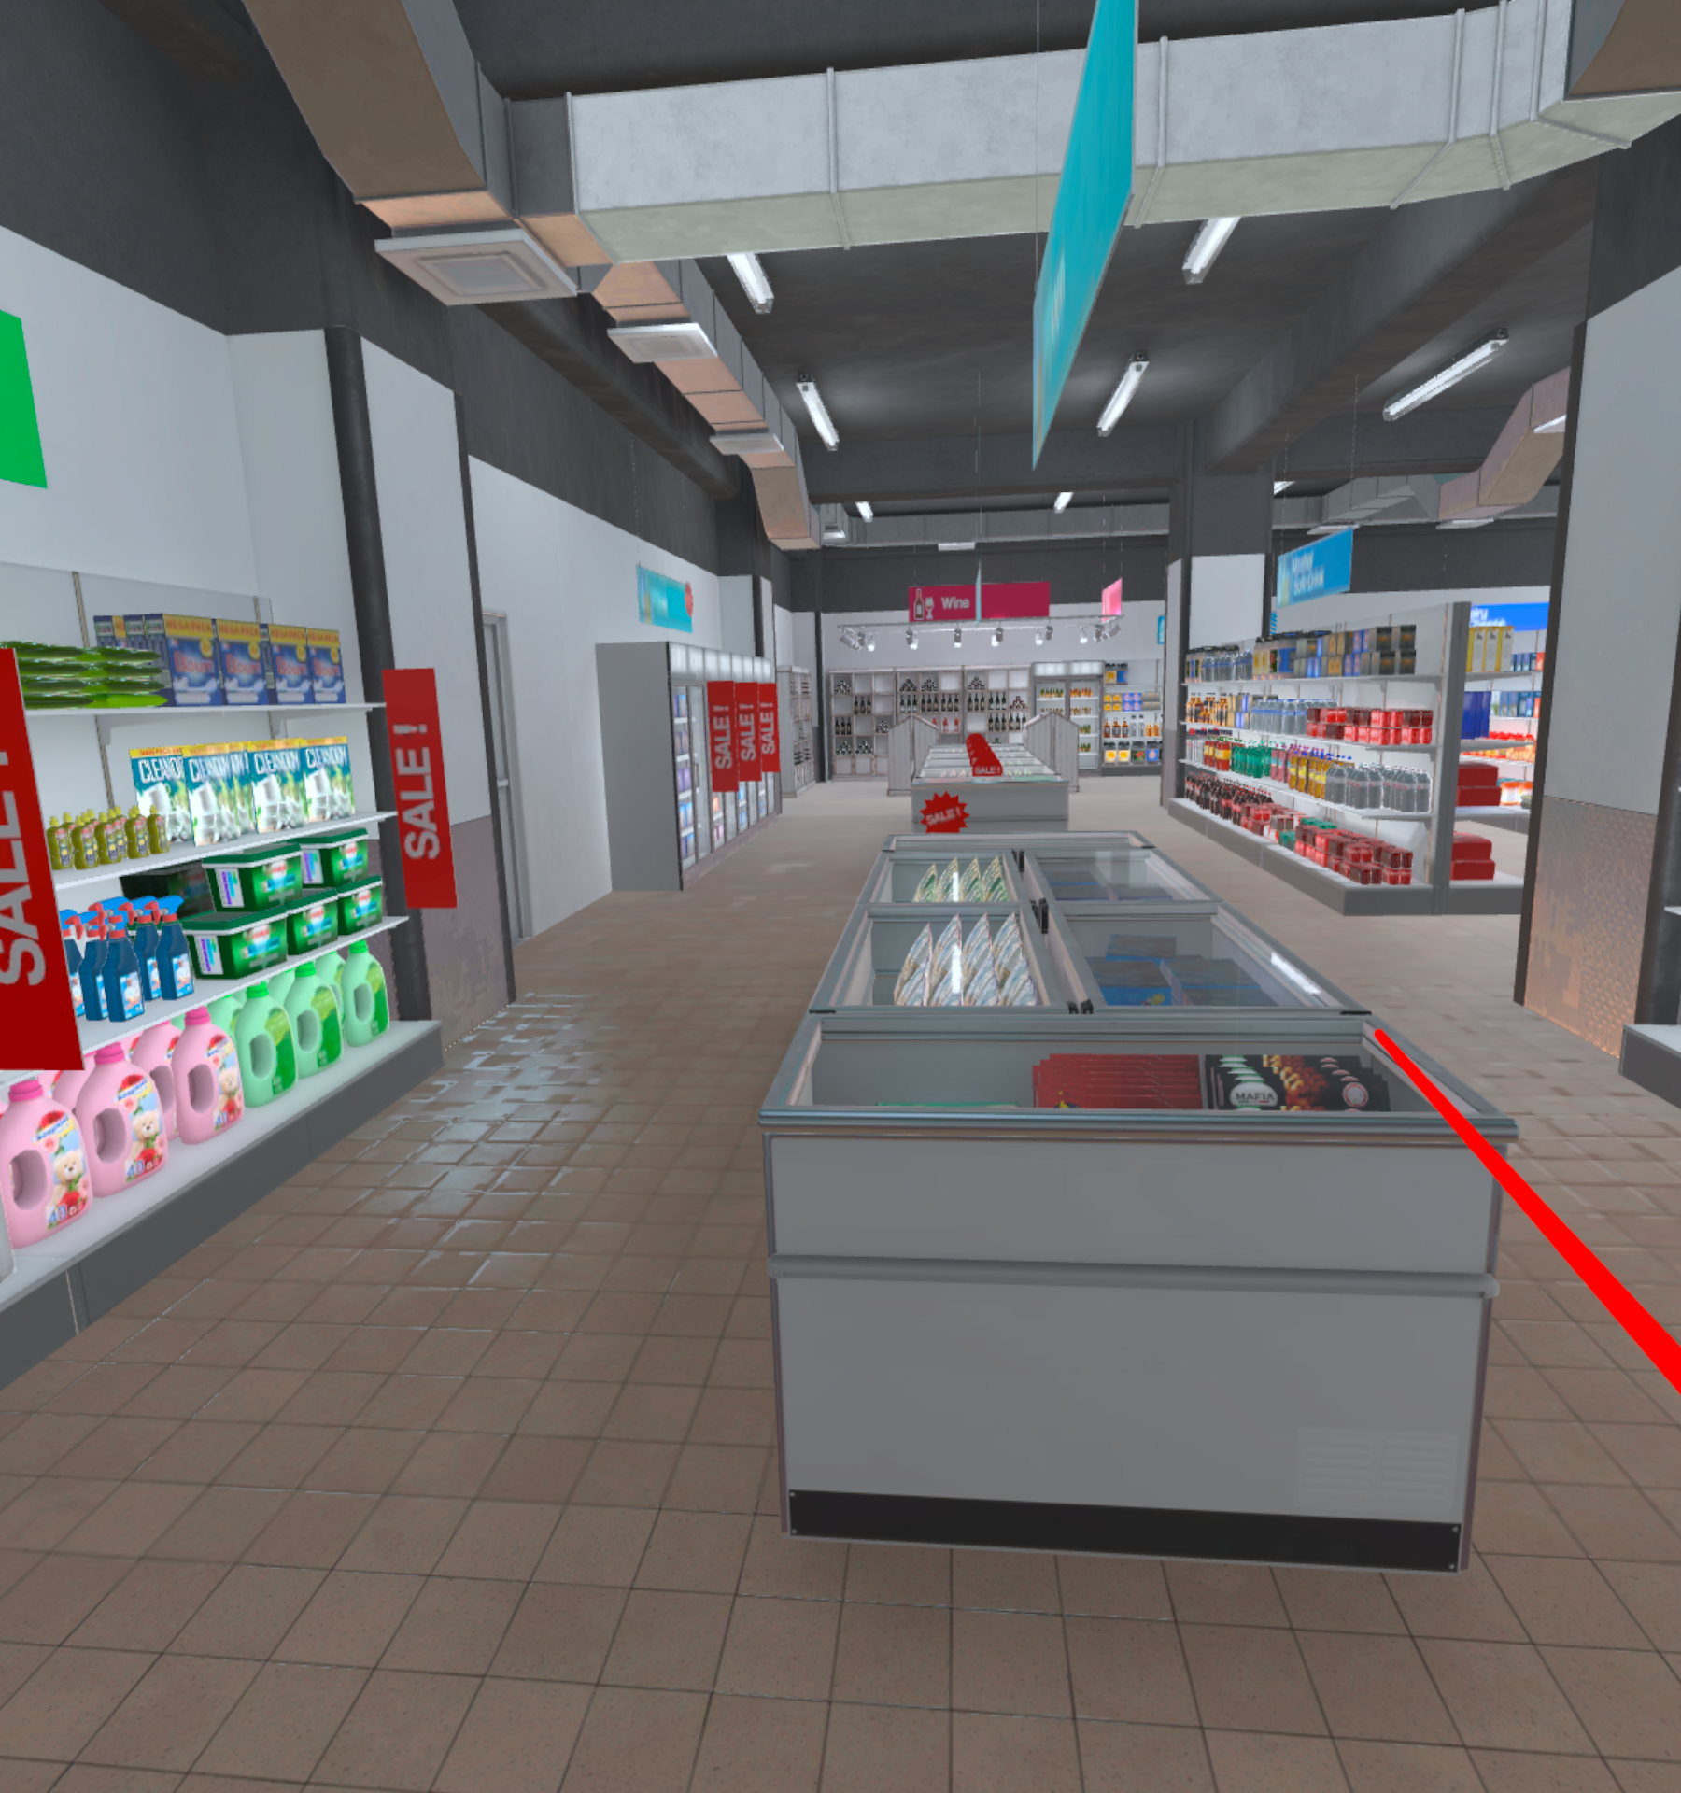
What Is Virtual Supermarket Test (VST)?
Introduction to Virtual Supermarket Test (VST)
The VST is a VR-based diagnostic designed for early detection of Alzheimer's disease.
Assessment Method
The VST assesses spatial navigation abilities, a common difficulty in early-stage Alzheimer's, through an interactive game format.
Development and Design
Developed using Unity game engine and C# language, the VST aims to provide a realistic and engaging diagnostic experience.
Diagnostic Metrics
The system records metrics like time taken, correct products found, bumps encountered, and moments of hesitation to aid in the diagnosis process.
Collaboration and Usability
Collaboration with medical experts ensured usability and effectiveness, enhancing the tool's diagnostic capabilities.
5
/
Early Alzheimer’s Diagnosis Using VR

Slide 6
Short Movie- click the icon
Link to Video
6
/
Early Alzheimer’s Diagnosis Using VR

Slide 7

Scenes and Flow: Navigating Through the Virtual
General Instruction
The subject should watch a brief video and then replicate the route they observed. The process is repeated five times for comprehensive assessment. There is a time limit to locate the product. If the user does not find it within the provided time, they proceed to the next navigation task.
Simulator
Users familiarize themselves with game mechanics using red rays from their hands.
A black canvas introduces the diagnostic game with clear instructions. Users learn to pick up products using a laser ray. Interactive tasks like picking up a green apple help users progress.
Mastering this skill is crucial for succeeding in subsequent stages.
Results
The system tracks whether the subject has located the product and records the time taken to find it.
7
/
Early Alzheimer’s Diagnosis Using VR

Slide 8
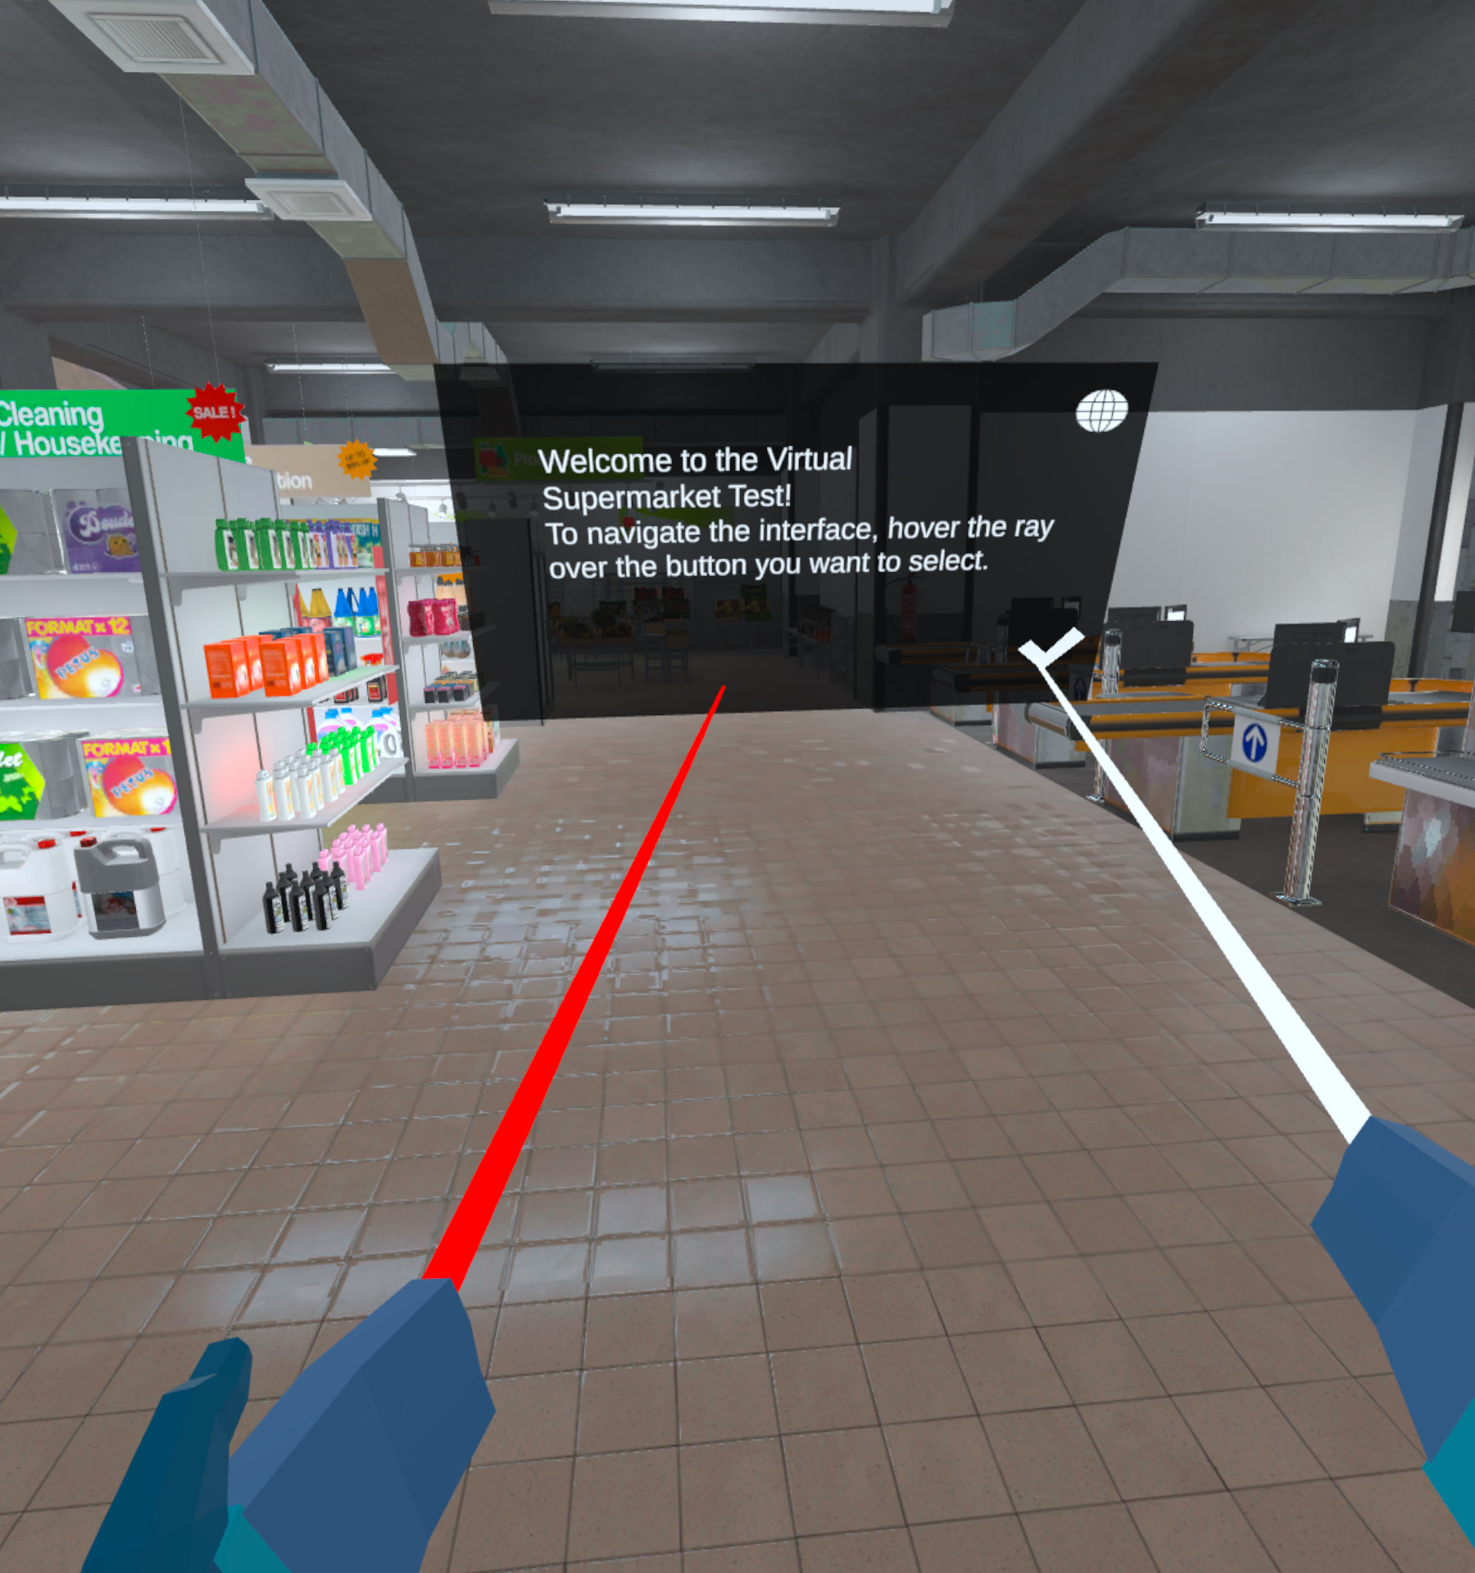
Welcome Screen: First Impressions Matter
Welcome Screen: First Impressions Matter
The Welcome Screen sets the tone for the VR diagnostic game, providing a realistic experience with 3D sounds and interactive elements.
Players are introduced to the simulator phase, learning step by step while getting accustomed to new red rays for navigation.
The introductory part lasts for one minute, ensuring a smooth transition into the immersive diagnostic experience.
The Welcome Screen includes a black canvas with introduction details and icon buttons for user interaction.
The combination of auditory cues, visual elements, and interactive features aims to engage users from the start.
8
/
Early Alzheimer’s Diagnosis Using VR

Slide 9
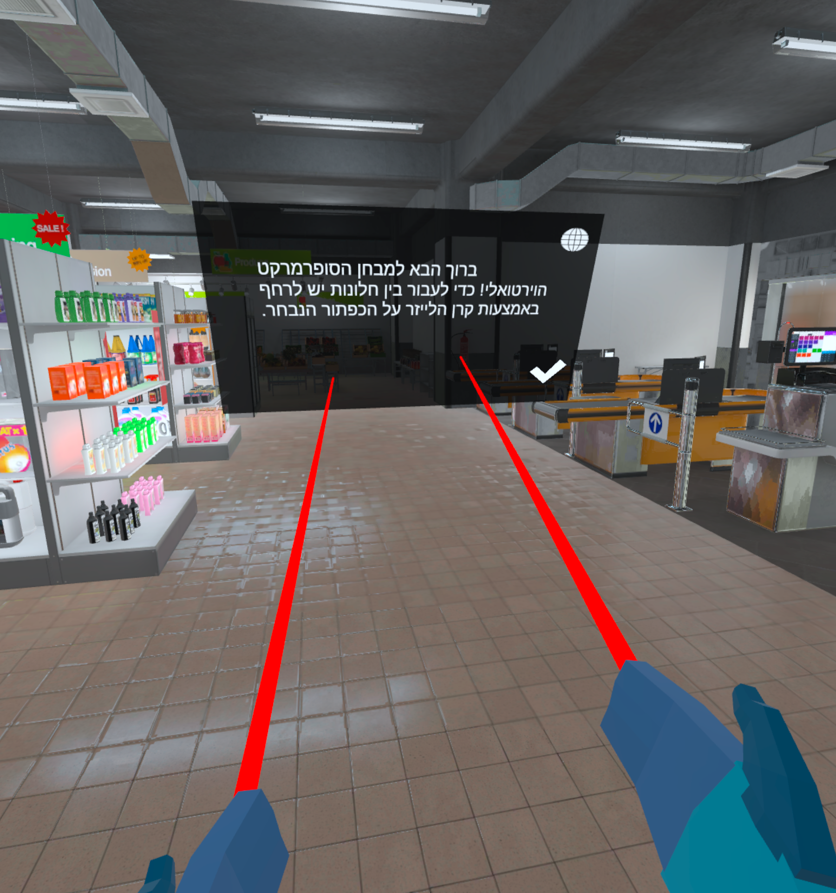
Language Support: Many older people do not know English
Language Support
The Simulator Screen accommodates multiple languages.
Ensures inclusivity and ease of understanding for a diverse user base.
Aligns with the goal of facilitating early Alzheimer's diagnosis through user-friendly interfaces.
9
/
Early Alzheimer’s Diagnosis Using VR

Slide 10
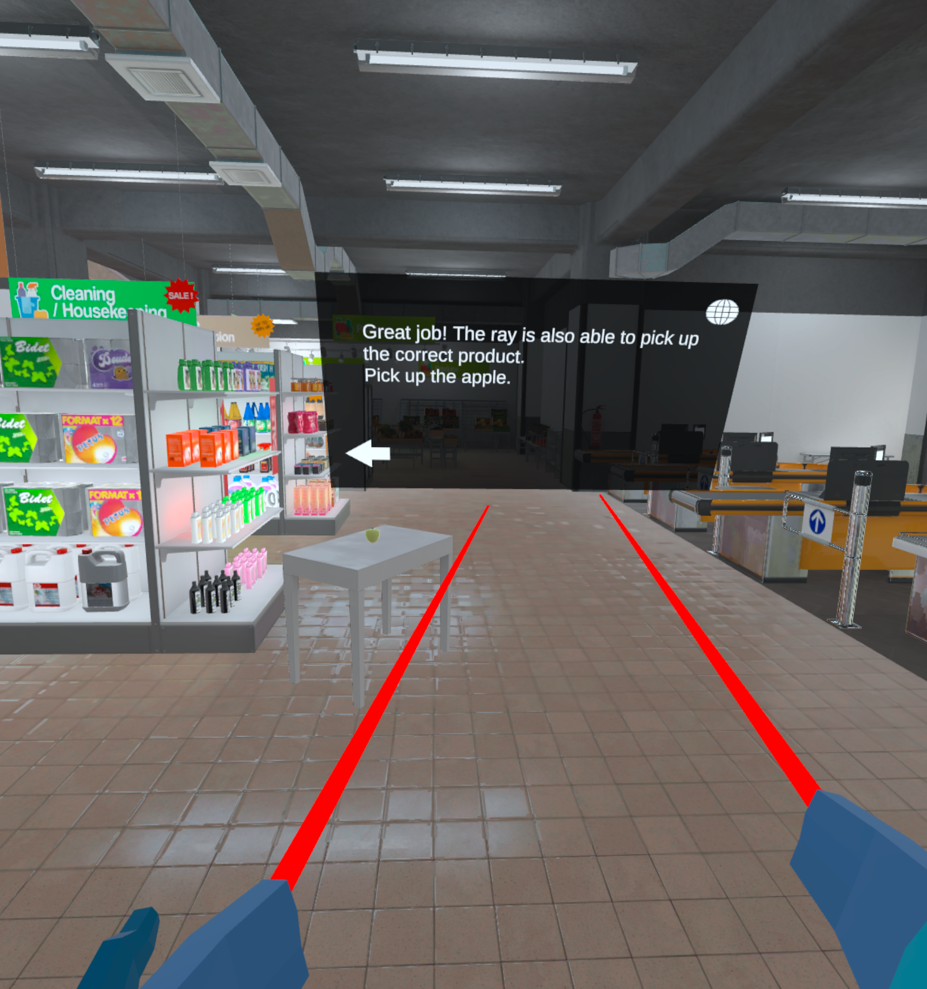
Simulator Screen: Immersive Diagnostic Game
Interactive Learning
The Simulator Screen provides an interactive learning environment where users can practice picking up products using a laser ray.
Ensures users are prepared for the diagnostic game stages.
Users must successfully pick up a product, like a green apple, to progress to the next screen.
Emphasizes the importance of mastering this skill for the subsequent game challenges
The instructions were modified based on observations of users interacting with the system for the first time.
10
/
Early Alzheimer’s Diagnosis Using VR

Slide 11
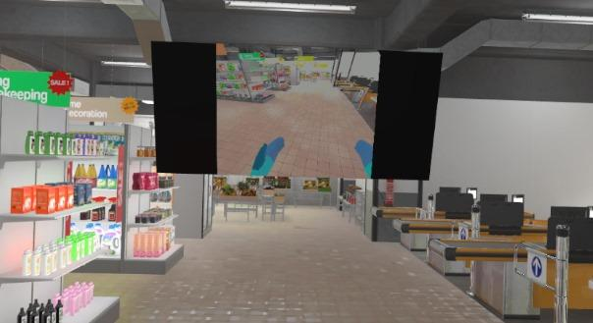
Video Screen
Replicate the route to the presented product
The short movies are recorded from a first-person perspective. In each movie, a product is marked, and the player must pick up that product or one from the same group to start the next navigation.
After picking up the correct product, the player is teleported to the next navigation area.
11
/
Early Alzheimer’s Diagnosis Using VR

Slide 12
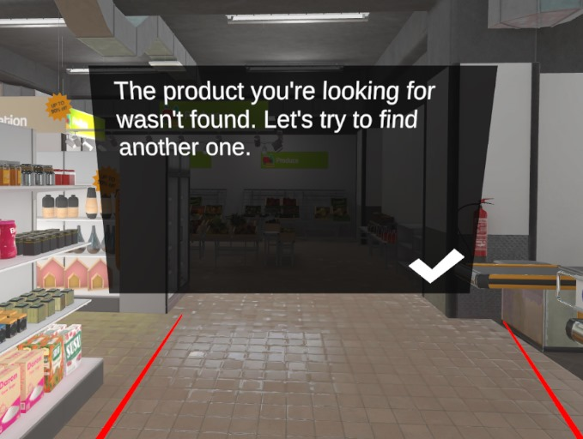
Not Finding Screen: Addressing Cognitive Challenges
Not Finding Screen: Addressing Cognitive Challenges
If the player struggles to find a product, a 'Not Found' screen appears, freezing movement until acknowledgment.
The user is then teleported to the next area to continue the navigation process.
This feature helps address cognitive challenges by providing feedback and guiding the user through the game.
12
/
Early Alzheimer’s Diagnosis Using VR

Slide 13

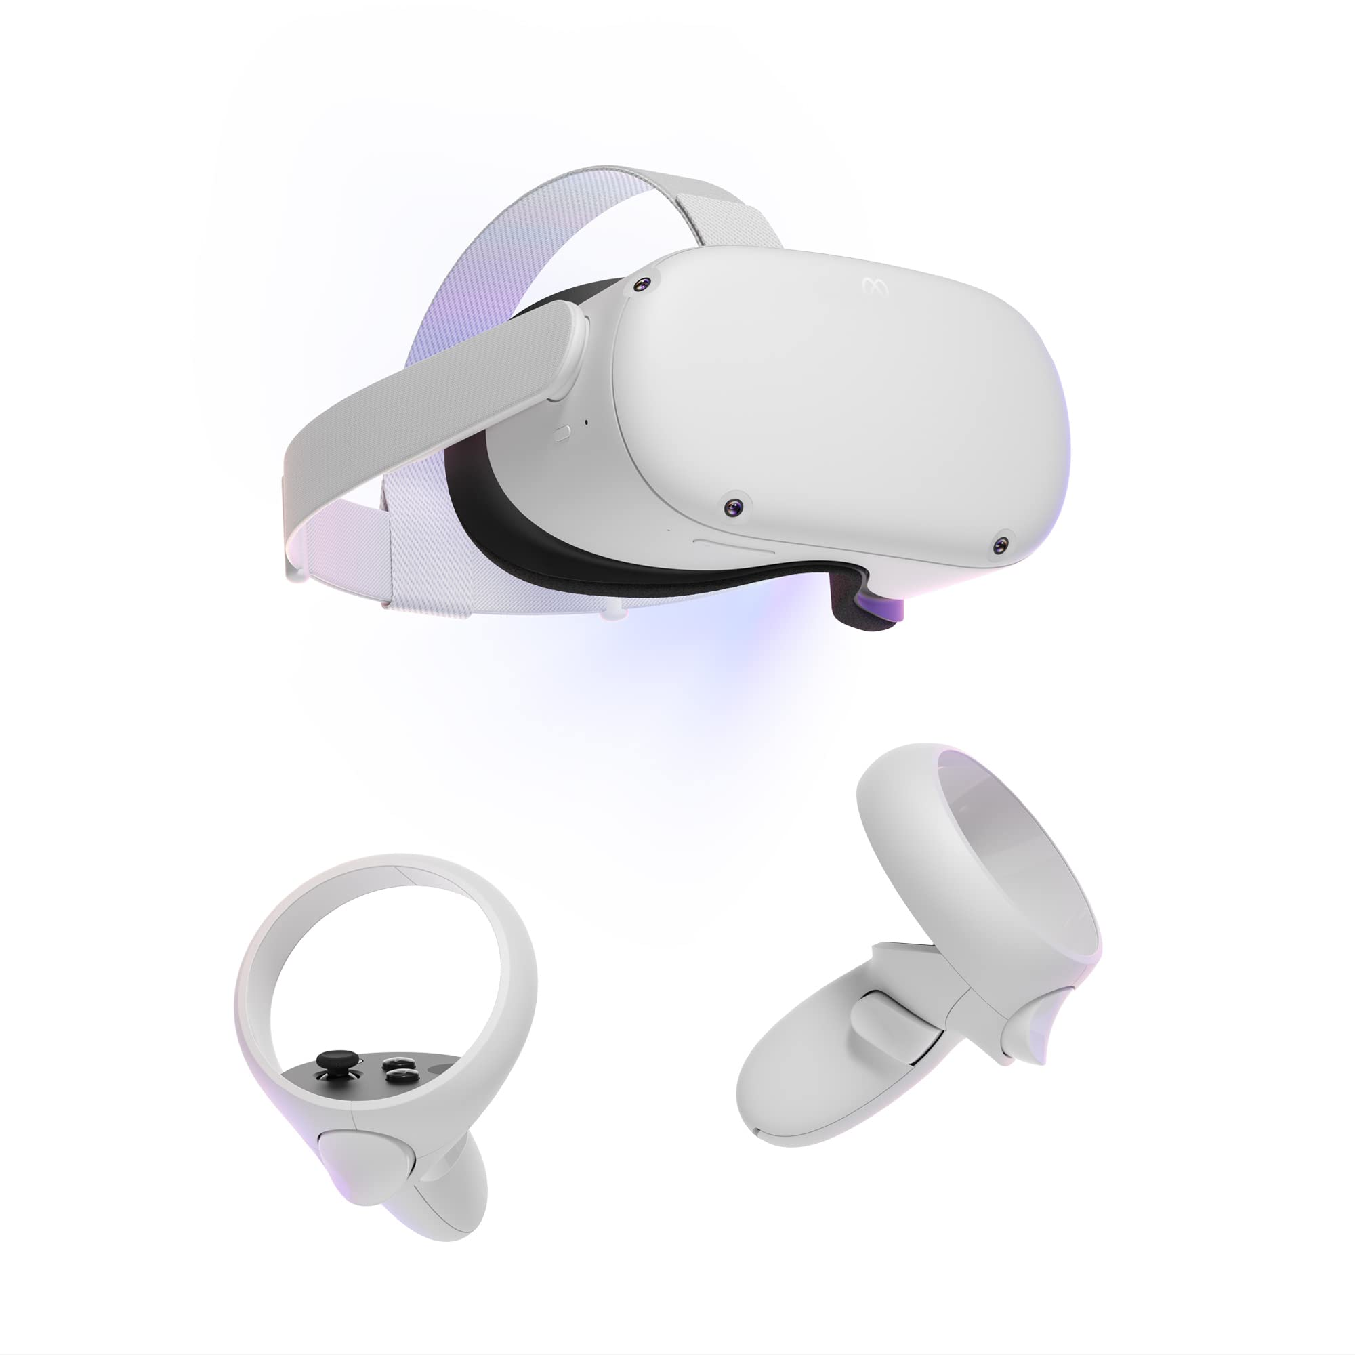


User Manual: Guide for Setup and Operation
Swivel Chair
Joysticks
System Acknowledgment
Headset
The user should be instructed to sit on a swivel chair such as a computer chair.
The assessor gives the user the joysticks and secure the ropes around the user’s hands, then have them hold the joysticks.
Ask the subject to move back and forth, and right and left, right and left. It’s the only button in the whole diagnostic game.
Only after these steps, place the headset on the subject’s head and help them adjust it to the right size.
15
/
Early Alzheimer’s Diagnosis Using VR

Slide 14
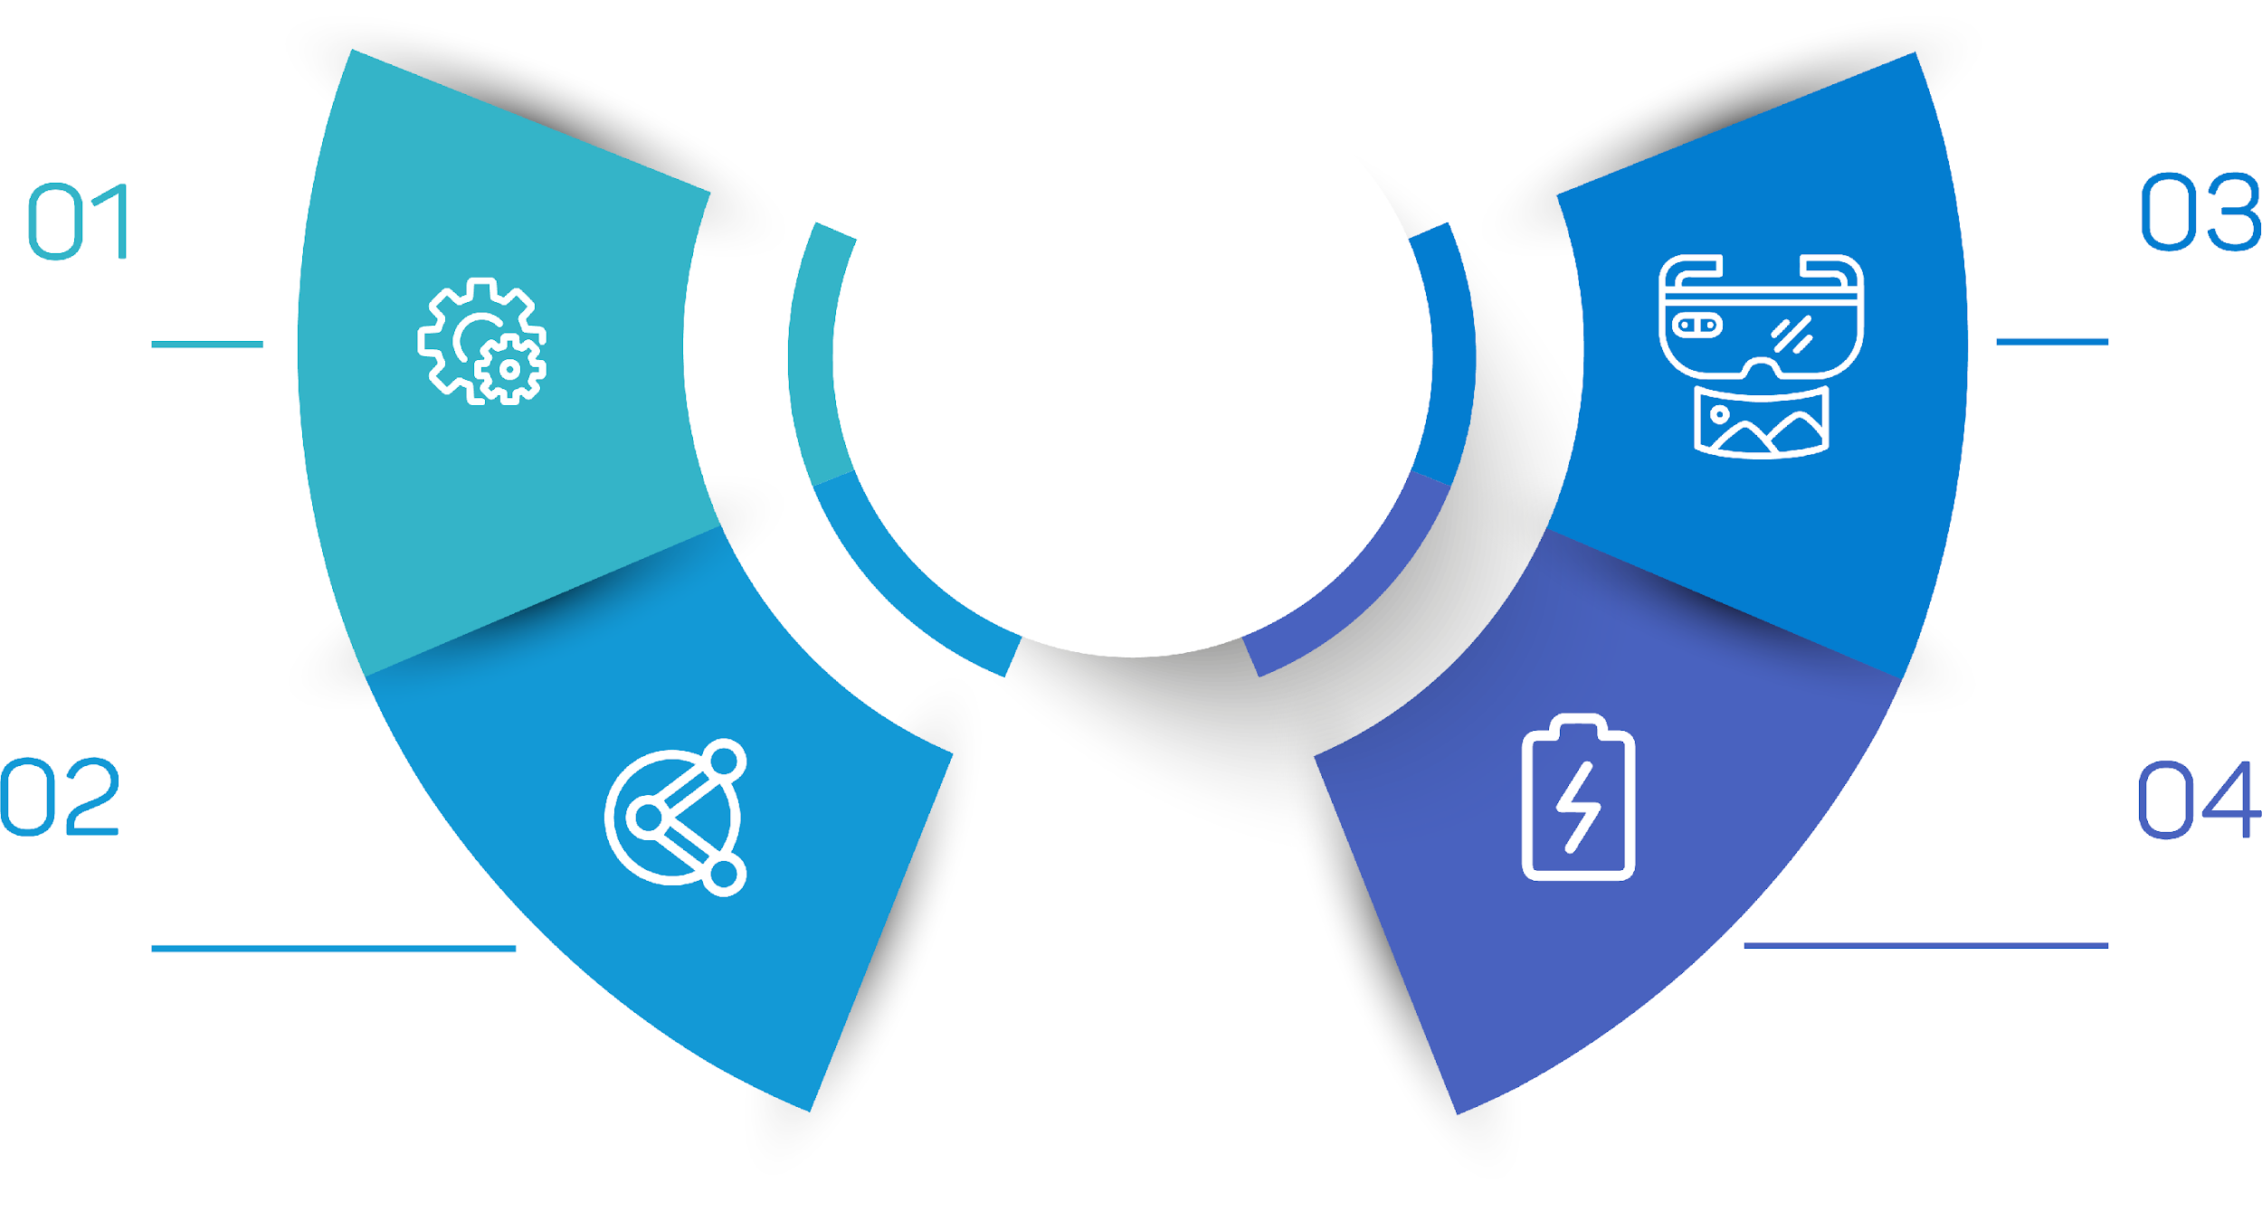
Instructor Manual
Guide for Setup
Turn on the Oculus device and open the Meta Horizon app. Ensure both are connected to the same Wi-Fi network.
The assessor should open the application inside the Oculus device.
The assessor should cast the Oculus device to their phone or another console using the Meta Horizon application and monitor the subject throughout the project.
the assessor must ensure the headset is fully charged before the diagnostic, the joystick has enough batteries, and there is a swivel chair available.
14
/
Early Alzheimer’s Diagnosis Using VR

Slide 15






Challenges and Solutions
Hardware Challenge
Overcoming compatibility issues with the graphics card for connecting the VR headset to the development environment
Requiring multiple trials with different models and configurations to find a suitable gaming card
Graphics Challenge
Addressing unexpected issues with the supermarket scene appearing pink
Indicating problems with shades or materials
Resolving the issue through various troubleshooting methods
Software and Debugging
Navigating the learning curve of working with Unity, C#, and the Oculus SDK
Improving proficiency in debugging techniques to enhance the development process
Low FPS Optimization
Optimizing frame rates to ensure a smooth and immersive user experience
Implementing strategies like occlusion culling, changing dynamic objects to static, and balancing graphical fidelity with performance
Integrating Features
Overcoming challenges in integrating functionalities like sending emails and showing videos within the VR environment
Finding solutions through innovative approaches like using Unity editor play mode for simulation
16
/
Early Alzheimer’s Diagnosis Using VR

Slide 16

Decisions: Key Choices in Development Process
Simplifying User Interaction
Opting for a laser pointer for product interaction.
Enhancing accessibility for older users.
Prioritizing Teleportation Functionality
Focusing on efficient teleportation capabilities.
Streamlining navigation within the virtual supermarket environment.
Progressive Navigation Tasks
Implementing a series of navigation tasks with increasing difficulty levels.
Assessing spatial navigation abilities based on user feedback.
Interactive Simulator Design
Developing an engaging and intuitive simulator.
Enhancing the overall user experience based on user preferences.
Balancing Realism and Simplicity
Striking a balance between realism and simplicity in the application design.
Ensuring user engagement and ease of use.
17
/
Early Alzheimer’s Diagnosis Using VR

Slide 17
Results
The process
The diagnostic game was evaluated with four participants, ages 55, 57, 75, and 75, all of whom had no prior experience with VR devices.
Participants were tasked with locating five products within a virtual environment, showcasing the varying abilities of older adults in navigating VR environments.
The test results highlighted both the potential and limitations of the diagnostic game in its current form.
The need for further refinement of the game was underscored to make it more accessible and effective for the older demographic.
1
18
Early Alzheimer’s Diagnosis Using VR
/
Enhancing Game Experience for Older Adults
/

Slide 18
Participant Performance
Ester Barak's Performance
Avi Ben Ari's Performance
Itzik Ben Ezra's Performance
Tsurit Barak's Performance
Age: 75
Found 1 out of 5 products
Took 120 seconds to find the first product
Experienced difficulty with joystick navigation
Age: 75
Found 2 out of 5 products
Took 93 seconds to find the first product
Took 130 seconds to find the second product
Age: 57
Successfully located all 5 products
Times to find products: 60s, 76s, 120s, 116s, 100s
Age: 55
Found all 5 products
Times to find products: 80s, 120s, 90s, 130s, 140s
19
/
Enhancing Game Experience for Older Adults

Slide 19

Conclusions
Increasing the number of test participants
Provides a wider variety of data points.
Enabling a more comprehensive analysis.
Capturing a broader spectrum of the target population.
Simplify Navigation
Redesign the game to make navigation more intuitive.
Ensure user-friendly interface for older demographic.
Extend Finding Time
Increase the available time for finding products.
Improve success rates for older users.
Reduce Product Count
Consider reducing the number of products.
Make the game more manageable for older users.
Adapt Teaching Stage
Streamline the teaching phase.
Help older users grasp game mechanics more quickly.
20
/
Enhancing Game Experience for Older Adults
Notes:
הגדלת כמות הנסיינים
כלי עזר למיפוי קוגנטיבי

Slide 20
Tools: Essential Application for Development
01
02
03
04
05
Unity Editor
Meta Quest Developer Hub
Visual Studio 2022
Oculus Quest 2 Device
C# Language
Primary development application for creating objects.
Managing packages.
Debugging performance in the VR diagnostic game development process.
Facilitates efficient device management.
Debugging for the Oculus Quest 2.
Ensures optimal performance during development.
Instrumental in coding for the VR diagnostic tool.
Offers extensive functionalities.
Provides powerful debugging tools for efficient development.
Utilized as the hardware platform for testing and deploying the VR-based diagnostic tool.
Provides a realistic and immersive experience for users.
Played a significant role in the development process.
Enables precise functionality.
Supports real-time programming for the VR diagnostic game.
21
/
Early Alzheimer’s Diagnosis Using VR

Slide 21


Testing: Ensuring Functionality and Usability
Test Number 4: Colors Test
The colors of the supermarket are correct, and there are no pink objects.
Status: Pass
Test Number 1: Picking Up Test
The user can pick up all five products in the VR environment,
with smooth and responsive handling.
Visual cues and clear instructions guide the process.
Status: Pass
Test Number 2: Teleport Test
The user teleports to the next navigation starting
point after picking up each product.
Status: Pass
Test Number 3: FPS Test
The frame rate is higher than 60 frames per second.
Status: Pass
Test Number 5: Losing Canvas Test
If the user fails to pick up the correct product within three times
the movie length, a losing canvas will pop up.
Status: Pass
22
/
Early Alzheimer’s Diagnosis Using VR

Slide 22

Future Features
01
02
03
04
05
Implementing AI Bot Players
Streamlining Data Transfer
Enhancing Video Display Capabilities
Prioritizing Immersive Features
User-Friendly Enhancements
Enhance realism in the diagnostic tool.
Measure user interactions effectively.
Send CSV files via email.
Facilitate convenient assessment of data.
Improve user engagement.
Enhance diagnostic experience.
Focus on features that improve diagnostic tool.
Ensure effective early Alzheimer's detection.
Ensure accurate diagnosis.
Support early detection of Alzheimer's disease.
23
/
Early Alzheimer’s Diagnosis Using VR
Notes:
זיהוי אנשים מוכרים
להתקשר לשלמה
מייל לאייל- לכתב את מרסלה וענת. דרישות למחשב

Slide 23

Summary
Hardware : Oculus quest 2
Software: Unity & C# for real-time programming and application maintenance
Challenges: Avoiding VR sickness, creating realism, optimizing movement
Optimization: Maximizing FPS, minimizing performance issues with post-processing techniques (occlusion, light baking)
Tools: Profiler, Stats, ADB for performance monitoring and stability
Iterative Development: Continuous feature improvement and learning, leading to an effective VR diagnostic tool
24
/
Early Alzheimer’s Diagnosis Using VR
Notes:
Acquiring hardware.
Utilizing Oculus Quest 2.
Unity game engine.
C# language.

Slide 24


